Slide 1

ARM
Audit Request Management
|

Slide 2


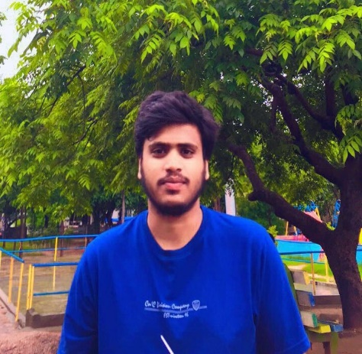
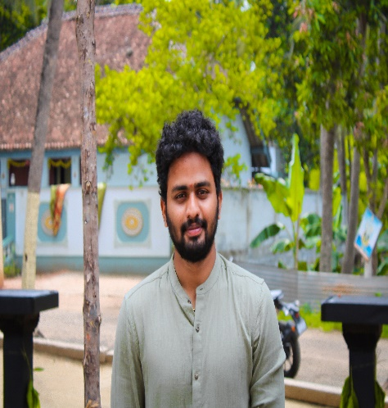
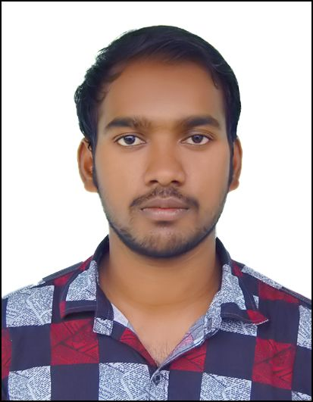
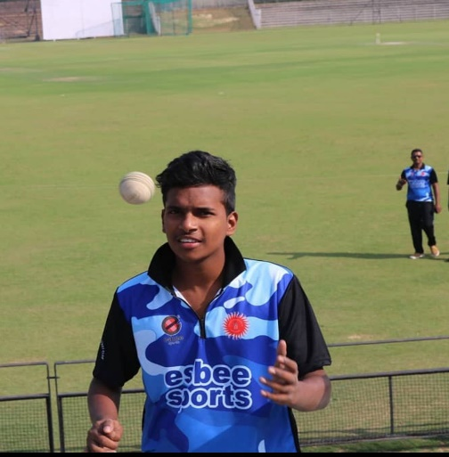
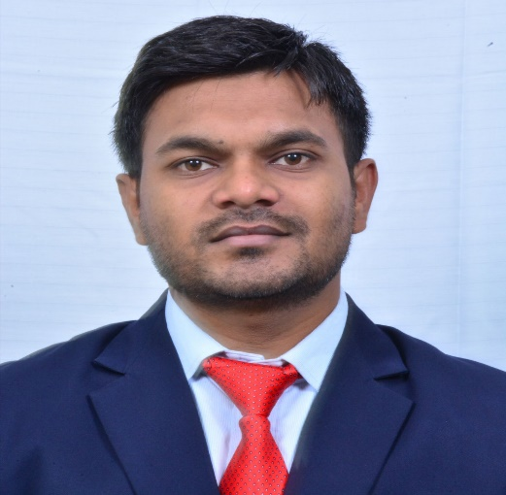
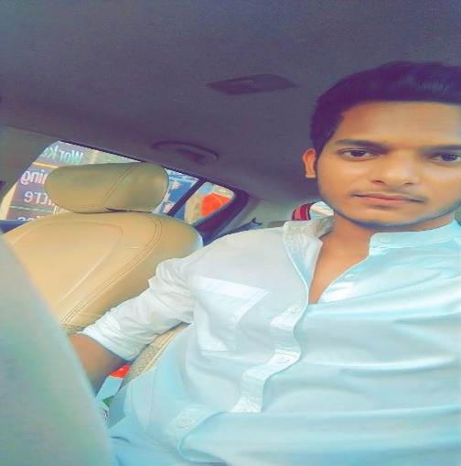
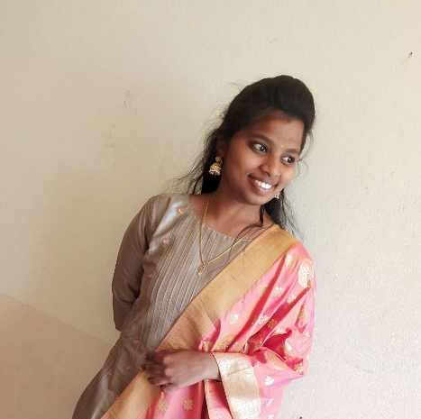
We are Gryffindor’s
Madhu
Dibya
Baba
Sandeep
SIKINDAR
Akash
ABUTHAIR
AWADESH
|

Slide 3
Audit Request Management
Business Case:
Motion Pictures Industry is fast growing and involves numerous stakeholders from the time an idea is conceived to actual release and go-to-market.
The more difficult part is how do these stakeholders get remunerated for their contributions, because there are a lot of anticipations and speculations that determine the payback in this specific industry.
That is where Contracts come in handy – ranging from very simple straight forward flat salary payment models to very complex Royalties, Residuals and Merchandise models that further vary depending on distribution channel, region, duration, etc.
With such contracts in place, the next difficult aspect is how do they track their Accounts Receivables and claim what is due to them.
This is where our Conceptual Product is going to help stakeholders to request and get paid for their efforts and contributions.

Slide 4









Tools & Technologies Used
|

Slide 5
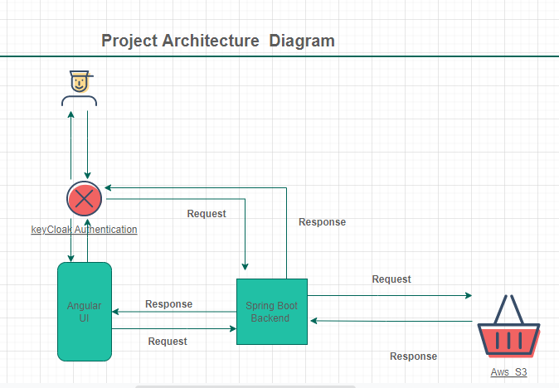
Architecture Diagram
|

Slide 6
Relations
Request
Task
Chatting
Uploading
Documents
@OneToMany
Notes:
Project details can have multiple upload-content(episodes), Each episode can have multiple scope-of-work. Task is having only one task-details.

Slide 7

Roles
Report
Owner
Manager
Roles | Manager | Report Owner
Create Request
Task Details
Chat
|
Notes:
Project details can have multiple upload-content(episodes), Each episode can have multiple scope-of-work. Task is having only one task-details.

Slide 8
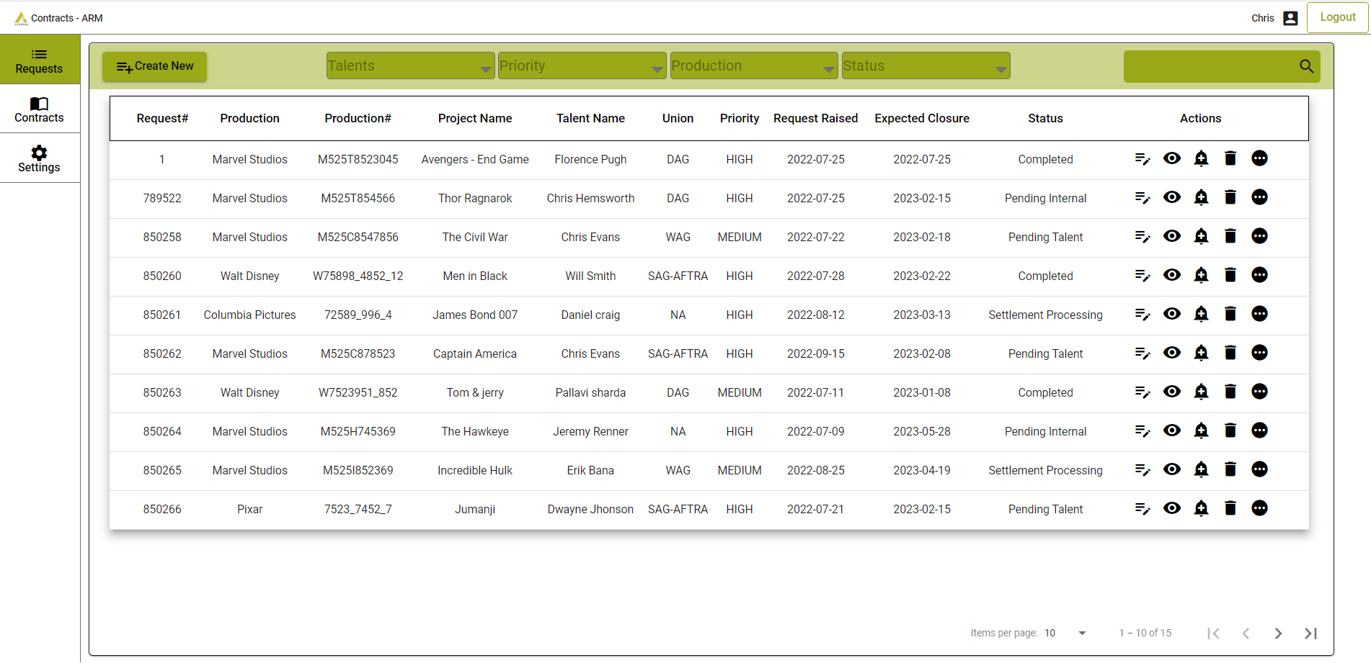
Project Dashboard view
|

Slide 9
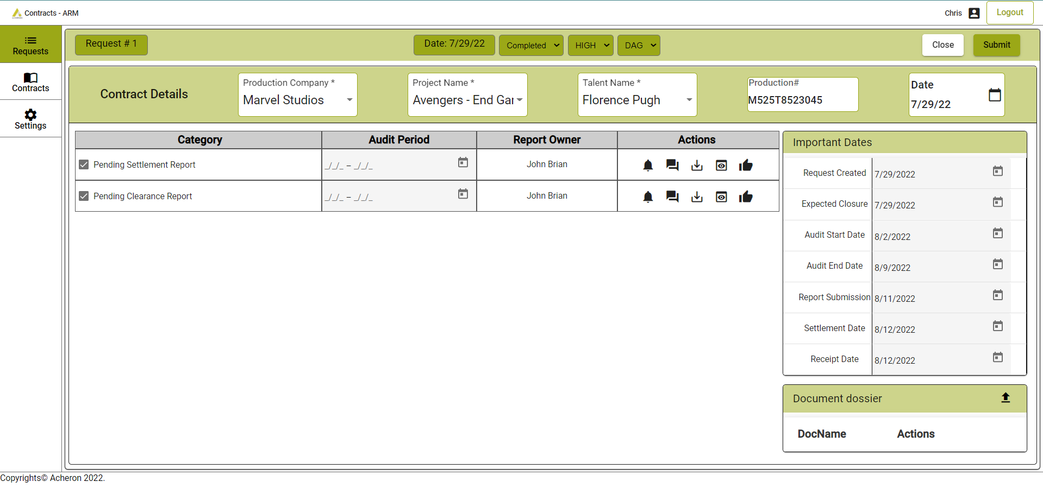
Request Details View Page
|

Slide 10
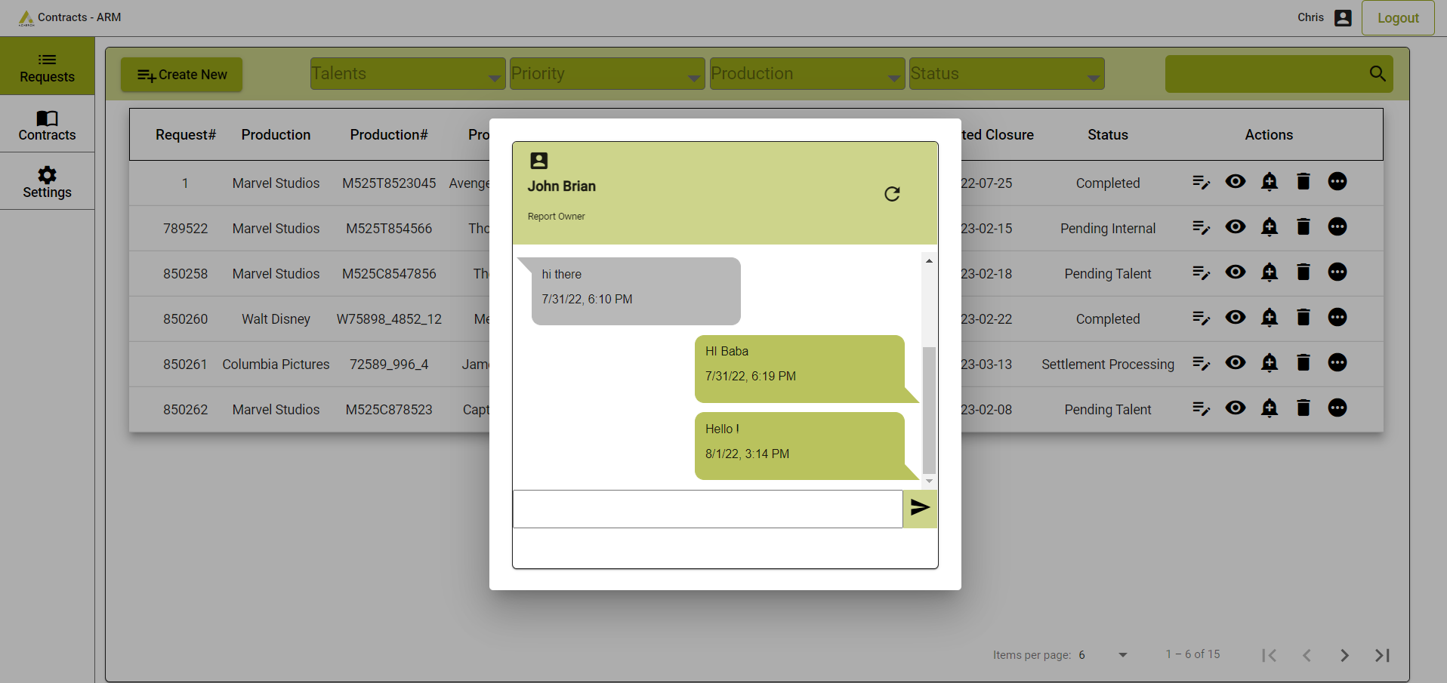
Chat Modal For Request Page (Manager Only)

Slide 11
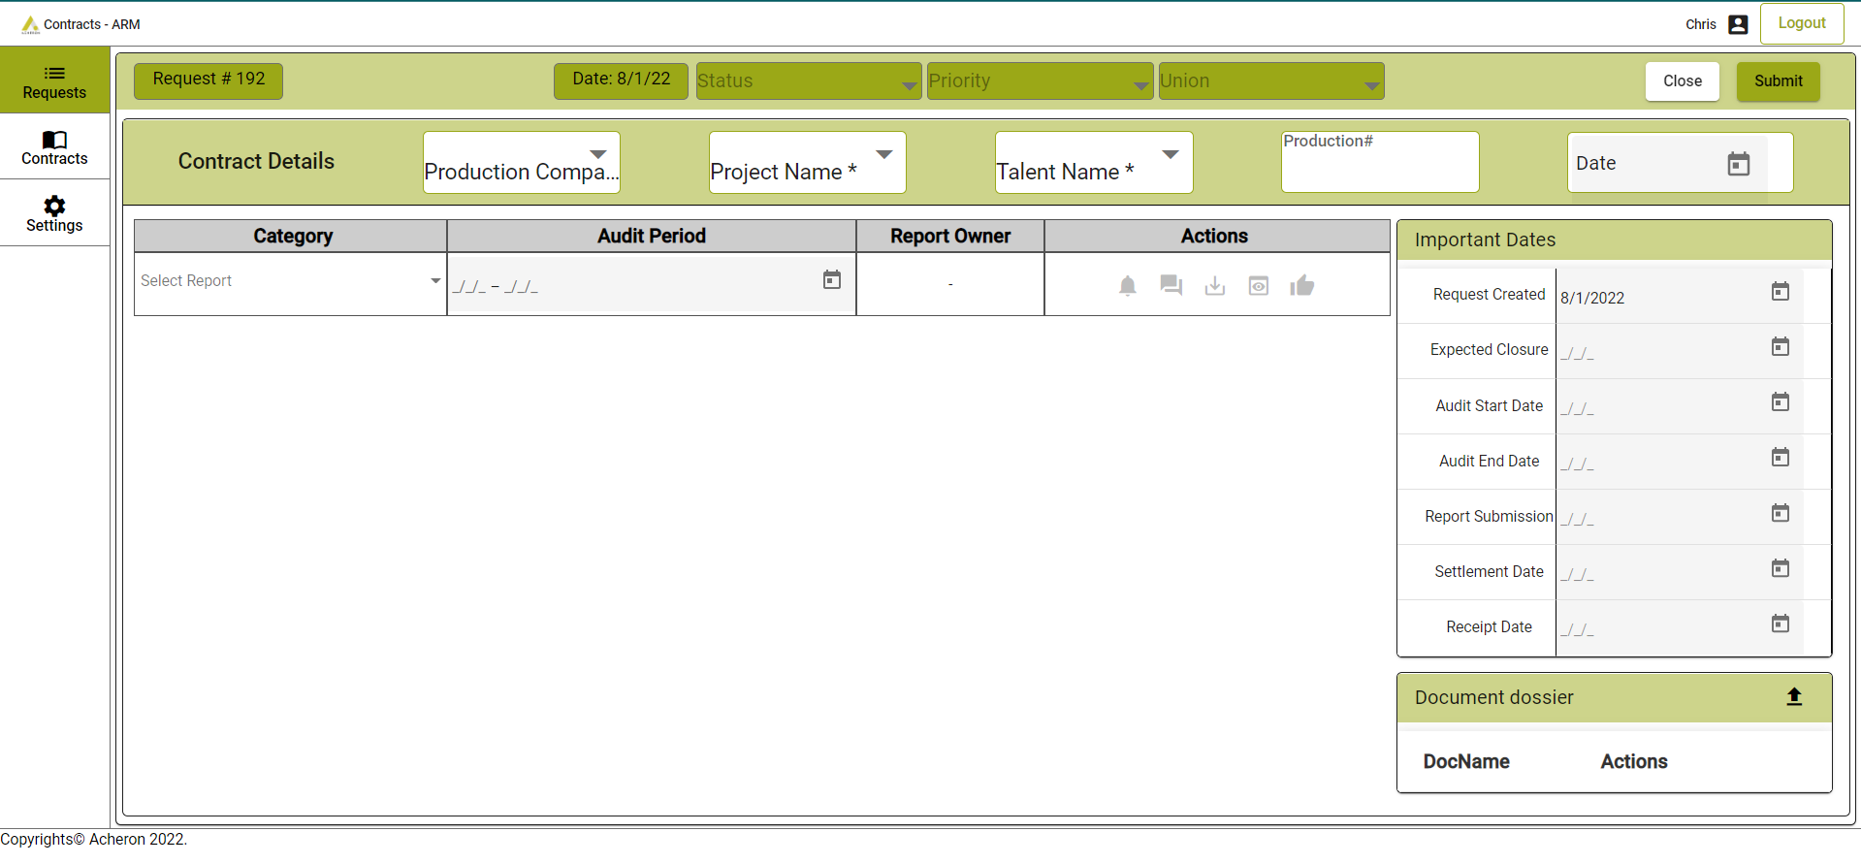
Create Request Page (Manager Only)
|

Slide 12
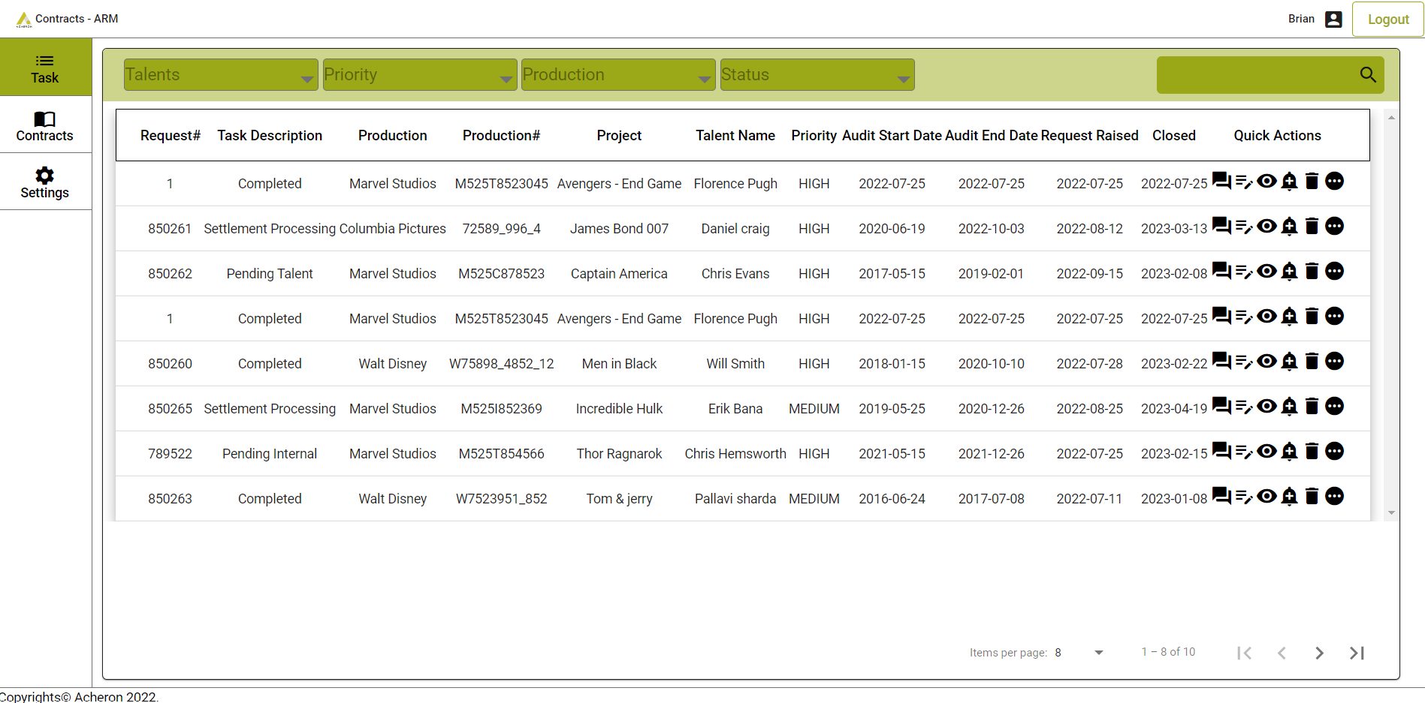
Task Page(Only Report Owner can access)
|

Slide 13
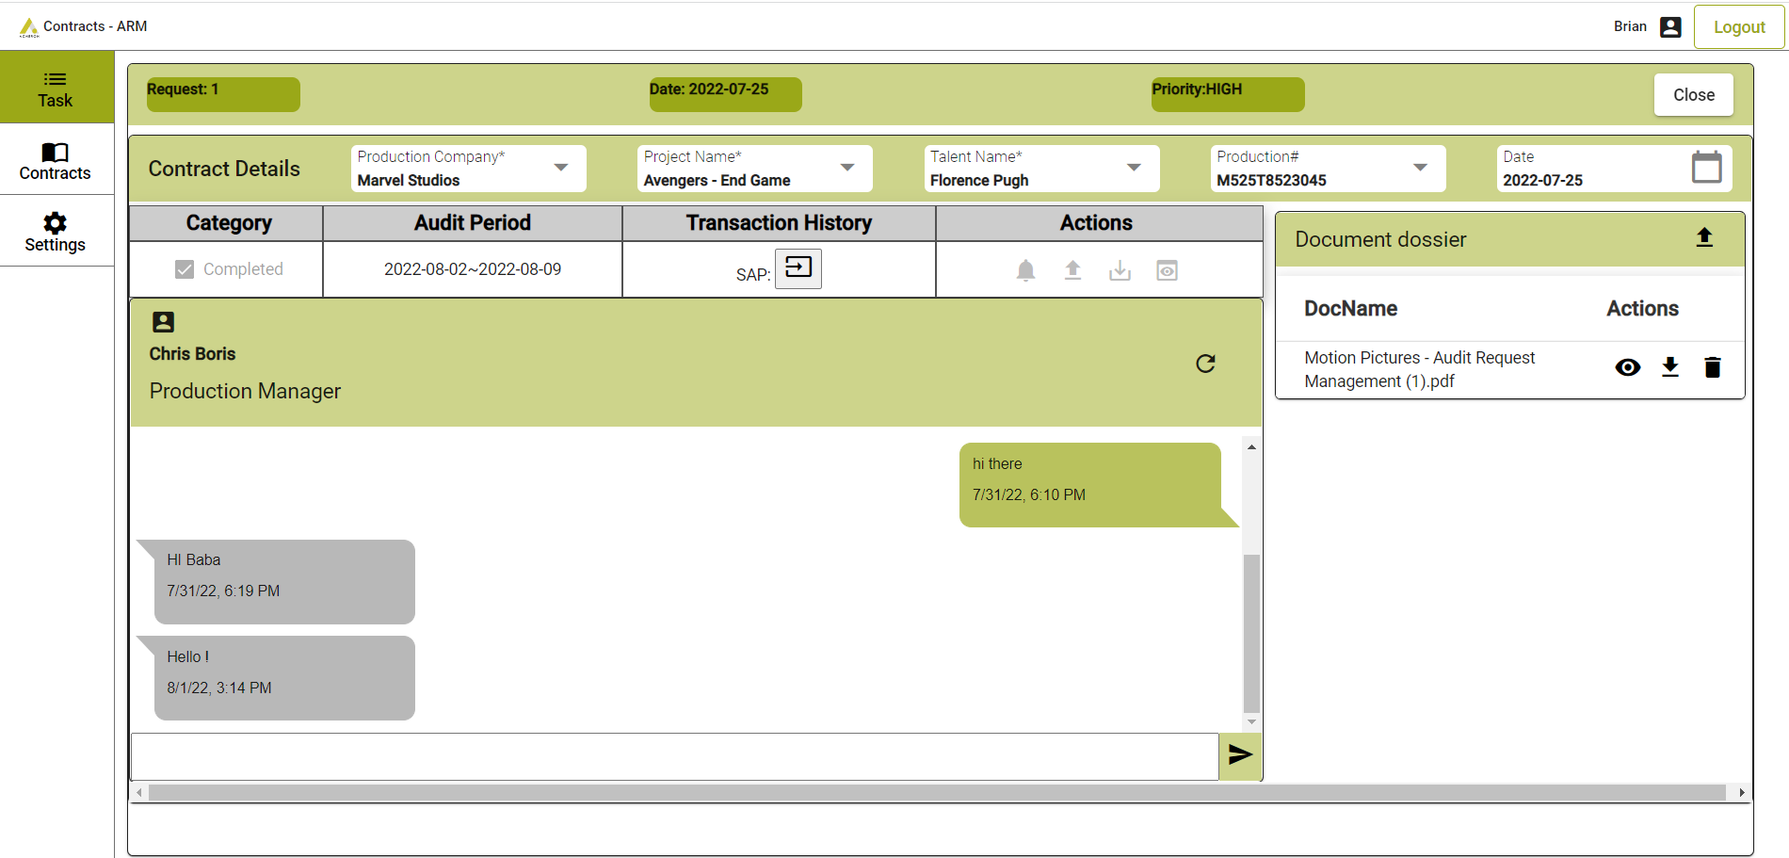
Chat Module
|

Slide 14
“THANK YOU”
We as a team rendered our efforts in every line of code with complete conviction and commitment. Mistakes, errors, incompletions travelled with us and taught us many things which we can't even articulate. we feel proud to be a part in this and with all our heads high and chins up saying…
+91 40 48551939
contact@acheron-tech.com www.acheron-tech.com Follow us @LinkedIn
|

